Slide 1
Verilog Design Introduction to Loops
EE417 Logic Design Using FPGAs

Slide 2
Loops in Verilog
For loops
While loops
Repeat loops

Slide 3
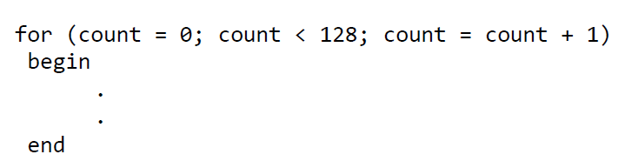
THE FOR LOOP:
The for loop is used with a non-register variable to form a repetitive flow.
module parity_for (parity, data);
parameter data_width = 7;
output reg parity;
input [data_width:0] data;
integer k;
always@(data)
begin
parity = 1;
for (k = 0; k <= data_width; k = k+1)
begin
if (data[k] == 1)
parity = ~parity;
end
end
endmodule
Initial value
Condition
Increment

Slide 4
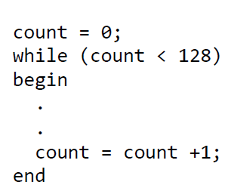
THE WHILE LOOP:
module parity_while (parity, data);
parameter data_width = 7;
output reg parity;
input [data_width:0] data;
integer k;
always@(data)
begin
parity = 1;
k = 0;
while (k <= data_width)
begin
if (data[k] == 1)
parity = ~parity;
k = k+1;
end
end
endmodule
Initial value
Condition for
repetition
Increment

Slide 5
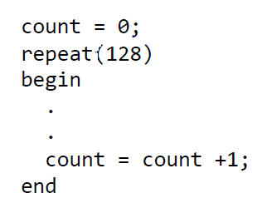
THE REPEAT LOOP:
 | Repeat is similar to the for loop. Instead of explicitly specifying a variable and incrementing it when we declare the for loop, we tell the program how many times to run through the code (unless we want to keep count).
Initial value
i = 0;
repeat (16)
begin
$display ("Current value of i is %d", i);
i = i + 1;
end
Number of repetitions
Increment
to keep track of the count

Slide 6
EXAMPALE:
module df_behav (q, q_bar, data, set_b, reset_b, clk);
input clk, data, set_b, reset_b;
output reg q,
output q_bar;
assign q_bar = !q;
always @ (posedge clk)
begin
if (reset_b == 1’b0) q<= 0;
else if (set_b == 1’b0) q<=1;
else q <= data;
end
endmodule
Explain the operation of the following Verilog code.

Slide 7
EXAMPALE:
module df_behav (q, q_bar, data, set_b, reset_b, clk);
input clk, data, set_b, reset_b;
output reg q,
output q_bar;
assign q_bar = !q;
always @ (posedge clk, negedge set_b, negedge reset_b)
begin
if (reset_b == 1’b0) q<= 0;
else if (set_b == 1’b0) q<=1;
else q <= data;
end
endmodule
Explain the operation of the following Verilog code.

Slide 8
EXAMPALE:
module loop(CLOCK_50, A, out);
input CLOCK_50;
input [15:0] A;
output reg [15:0] out;
reg [15:0] r;
reg [4:0] count;
initial out = 16'd0;
always @ (posedge CLOCK_50)
begin
r <= A;
for(count = 0; count <= 16'd15; count = count+1)
begin
if (count % 2 == 0) out [count] <= r[count];
else out [count] <= ~r[count];
end
end
endmodule
Explain the operation of the following Verilog code.

Slide 9
EXAMPALE:
module loop(CLOCK_50, A, out);
input CLOCK_50;
input [3:0] A;
output reg [5:0] out;
reg [3:0] r, count;
initial
begin
out = 6’b00_0000;
count = 4’d0;
r = 4’b0000;
end
always @(posedge CLOCK_50)
begin
r <= A;
if (count <= 4)
begin
out <= out + r;
count <= count + 1;
end
end
endmodule
Explain the operation of the following Verilog code.

